Slide 1

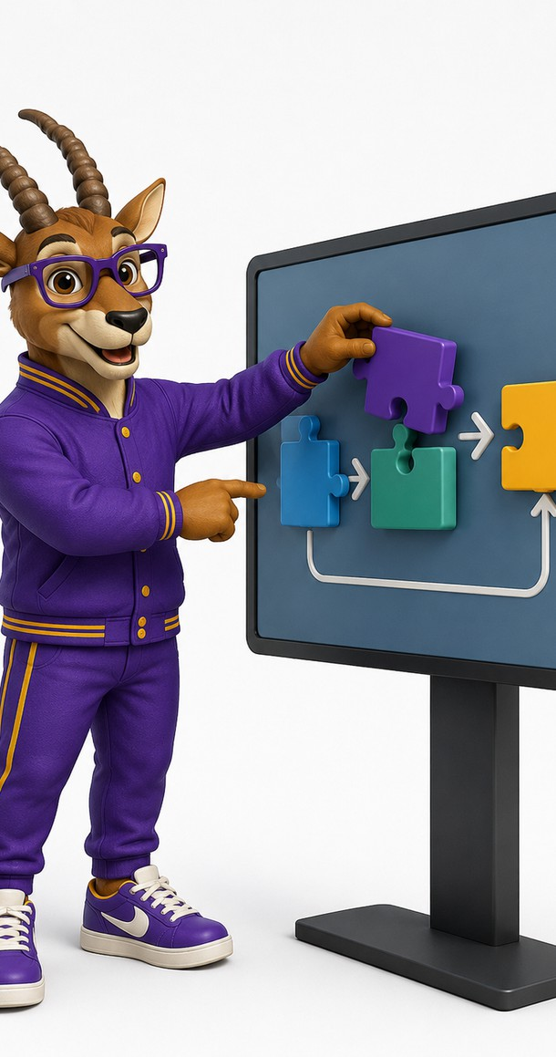
CAREER PILOT– AI-BASED PERSONALIZED STUDENT CAREER ADVISOR
DEPARTMENT OF ARTIFICIAL INTELLIGENCE AND MACHINE LEARNING
Team Members
SAILESH RANGARAJ. (231501141)
UMESH SARATHY SK. (231501177)
VIGNESH BALA R. (231501180)

Slide 2

1
Problem Statement
Problem Definition
Students often have multiple skills, projects, certifications and academic experiences but struggle to connect them with suitable career opportunities.
Key Challenges:
Difficulty identifying suitable job roles
Lack of personalized skill-gap analysis
Uncertainty about what skills to learn next
Scattered career and learning resources
Generic recommendations from conventional chatbots
Risk of unsupported or exaggerated claims in AI-generated applications
No unified workflow from profile → job → skills → learning → application
Business / Real-World Context
College students preparing for placements
Internship and entry-level job seekers
Placement and career cells
Faculty and career mentors
Academic career-support teams

Slide 3
User and Stakeholder Analysis
2
Target Users
Stakeholder Identification
Stakeholder | System Support
Student | Profile analysis, jobs, roadmap, application drafts
Placement Cell | Scalable first-level advising
Faculty / Mentor | Skill-gap & roadmap summaries
Administrator | Job & knowledge-source management
Students
Placement / Career Cell
Faculty / Mentors
System Administrator

Slide 4
Proposed System: Analysis Pipeline
3
1
Student Profile Input
2
Profile & Career Analysis
3
Job Discovery & Skill-Gap Analysis
Collect the student’s academic background, skills, projects, experience, and career interests.
The agent analyzes the profile and identifies suitable career directions and relevant capabilities.
Search the structured job database and compare job requirements with the student’s existing skills to identify gaps.
4
Agentic Knowledge Retrieval
5
Personalized Recommendation Generation
6
Reflection & Human Approval
The agent determines whether additional career or skill-roadmap knowledge is required and retrieves relevant information when necessary.
Generate a customized learning roadmap and application materials based on the identified career goals and skill gaps.
Review the generated content for unsupported claims, refine it when required, and obtain human approval before any consequential application action.

Slide 5
4
Proposed System: Data Sources
Transforms a student’s academic profile and career goals into personalized, actionable career recommendations through an Agentic AI workflow.
Profile Input
Agent Analysis
Job Discovery
Agentic RAG
Personalized Generation
Student Profile
Collects academic details, technical skills, projects, experience, and career interests.
Profile & Goal Analysis
Analyzes the student profile and determines the appropriate career direction and next action
Job & Skill Matching
Searches relevant job opportunities and compares required skills with the student’s existing capabilities.
Adaptive Knowledge Retrieval
Determines when additional career or skill-roadmap knowledge is required and retrieves relevant information.
Learning & Application Support
Generates personalized learning roadmaps and application materials based on identified skill gaps.

Slide 6
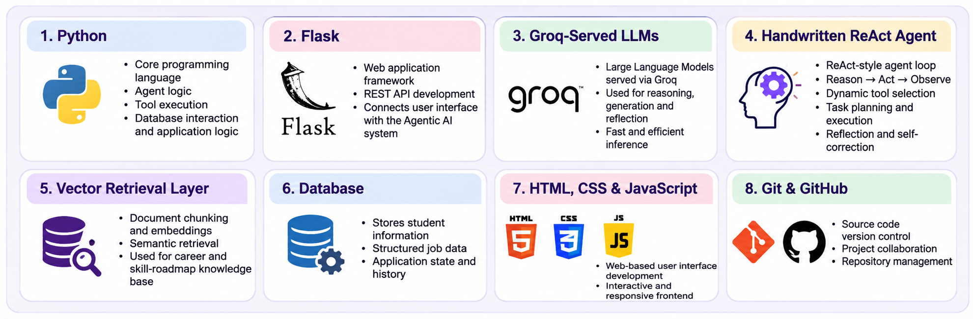
TOOLS AND TECHNOLOGIES USED
5

Slide 7
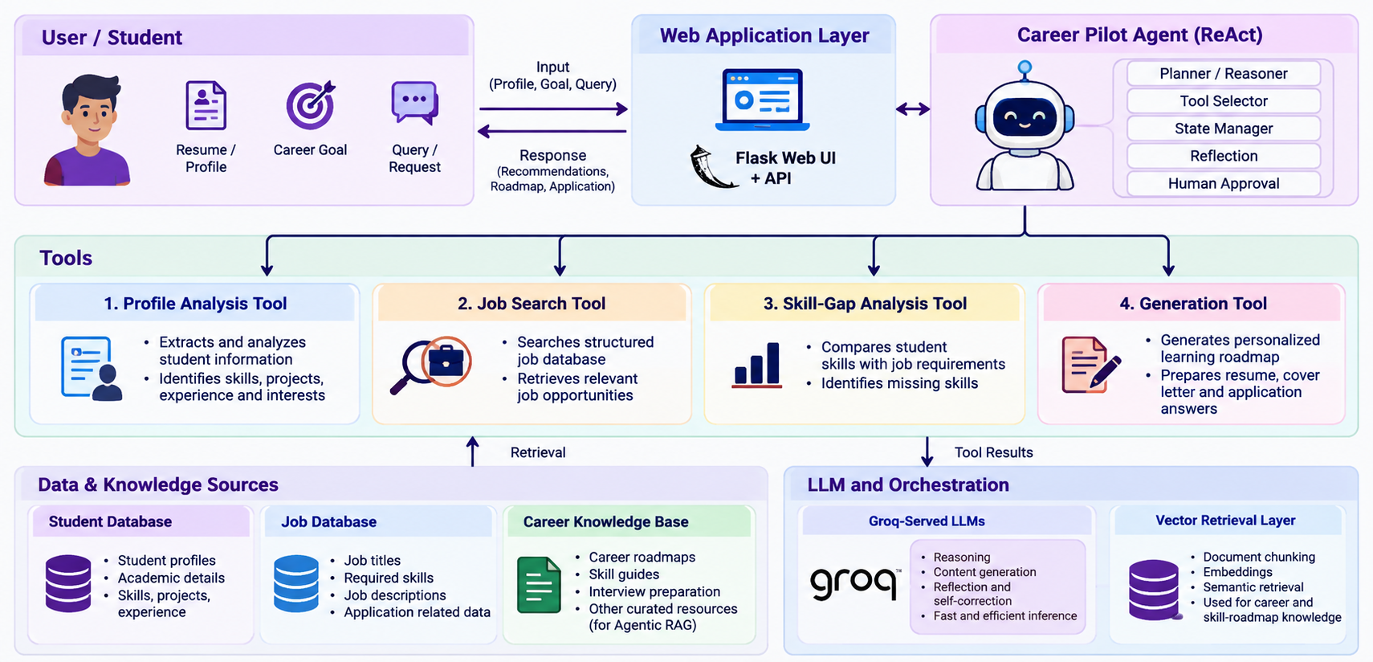
6
AGENTS ARCHITECTURE
Final review
Department of Artificial Intelligence and Machine Learning

Slide 8
7
AGENTS RESPONSIBILITIES
The proposed system consists of seven specialized agents coordinated by LangGraph.
Planner / Reasoner
Understands the student’s request and determines the next appropriate action.
Tool Selector
Selects and invokes the appropriate tool based on the current task requirements.
Profile Analysis
Analyzes student information and identifies relevant skills, projects, experience, and interests.
Job Search & Skill-Gap Analysis
Retrieves suitable job opportunities and compares job requirements with the student’s existing skills.
RAG Controller
Decides whether additional career or skill-roadmap knowledge is required and triggers targeted retrieval when necessary.
Generator
Produces personalized learning roadmaps and application-related content such as resumes, cover letters, or answers.
Reflection Reviewer
Reviews generated application content, identifies unsupported or exaggerated claims, and corrects them.
Final review
Department of Artificial Intelligence and Machine Learning

Slide 9
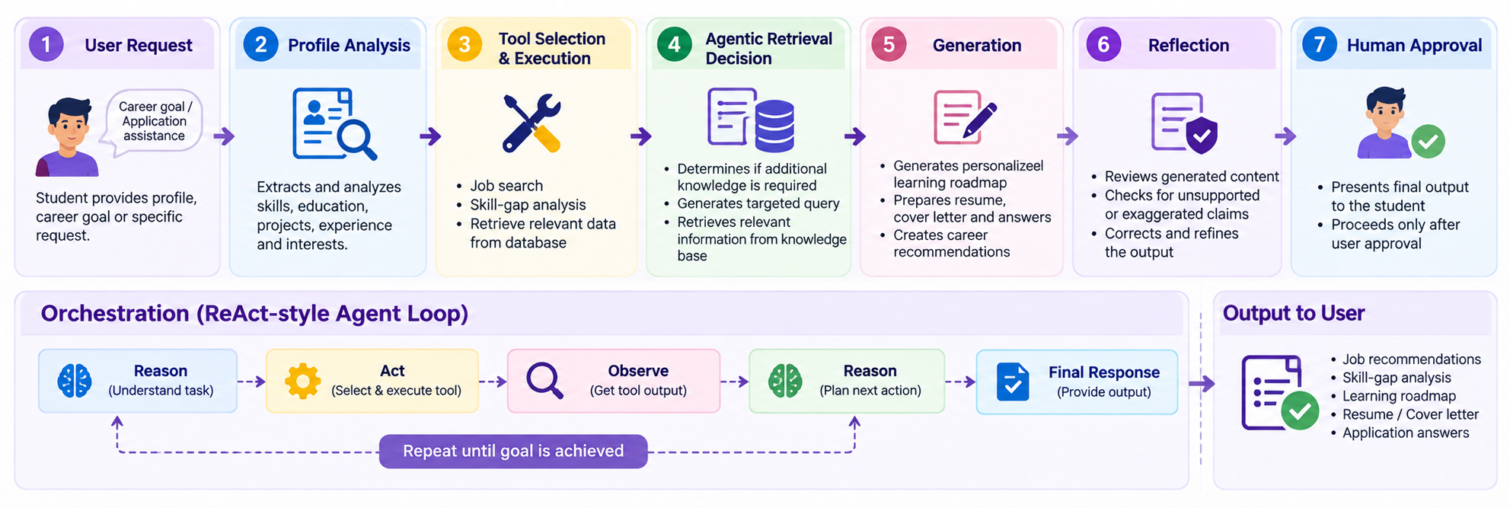
8
AGENT WORKFLOW AND ORCHESTRATION
Final review
Department of Artificial Intelligence and Machine Learning

Slide 10
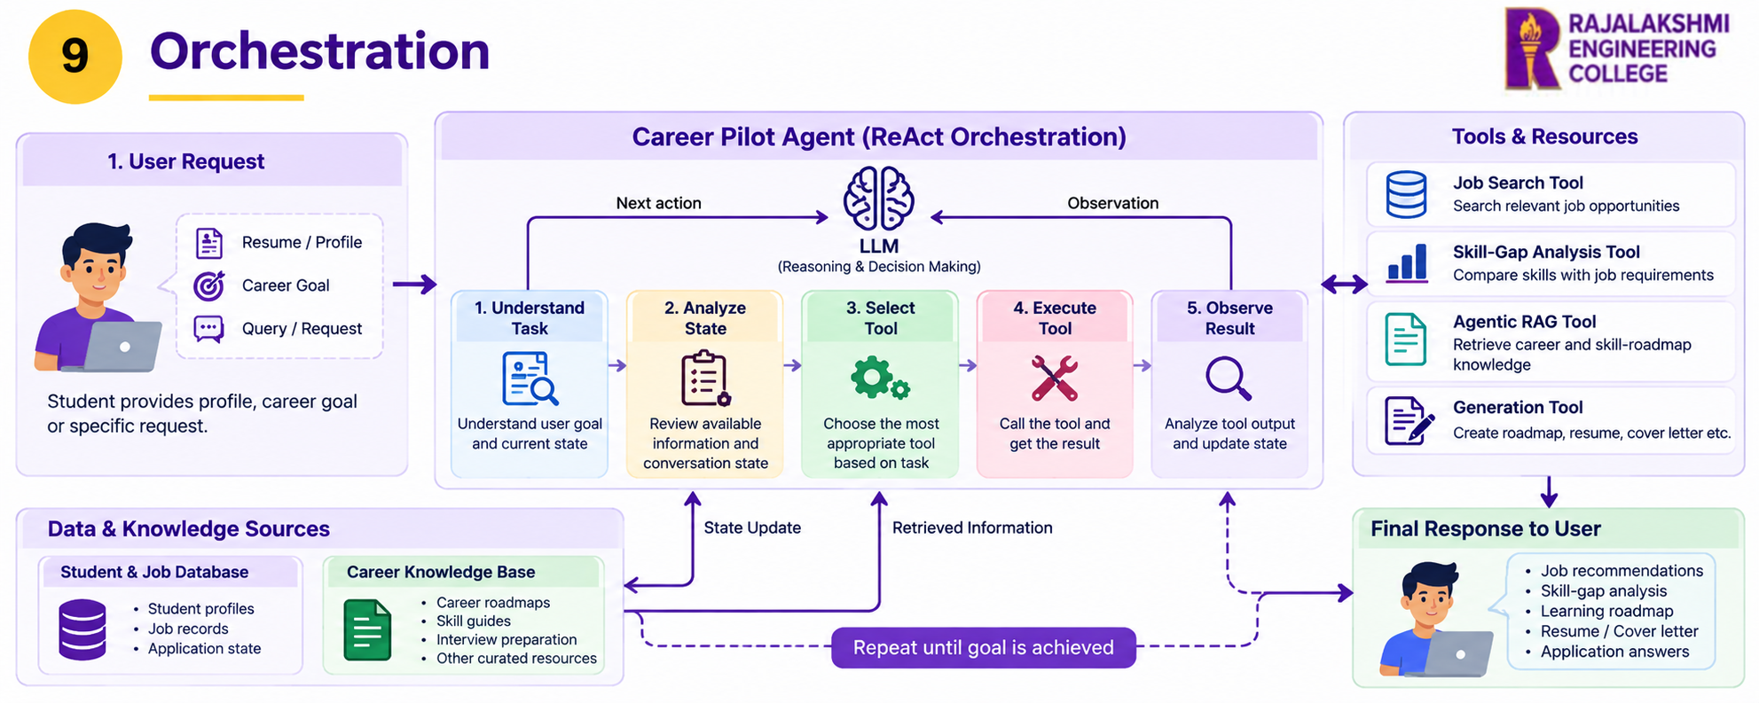
ORCHESTRATION
9

Slide 11
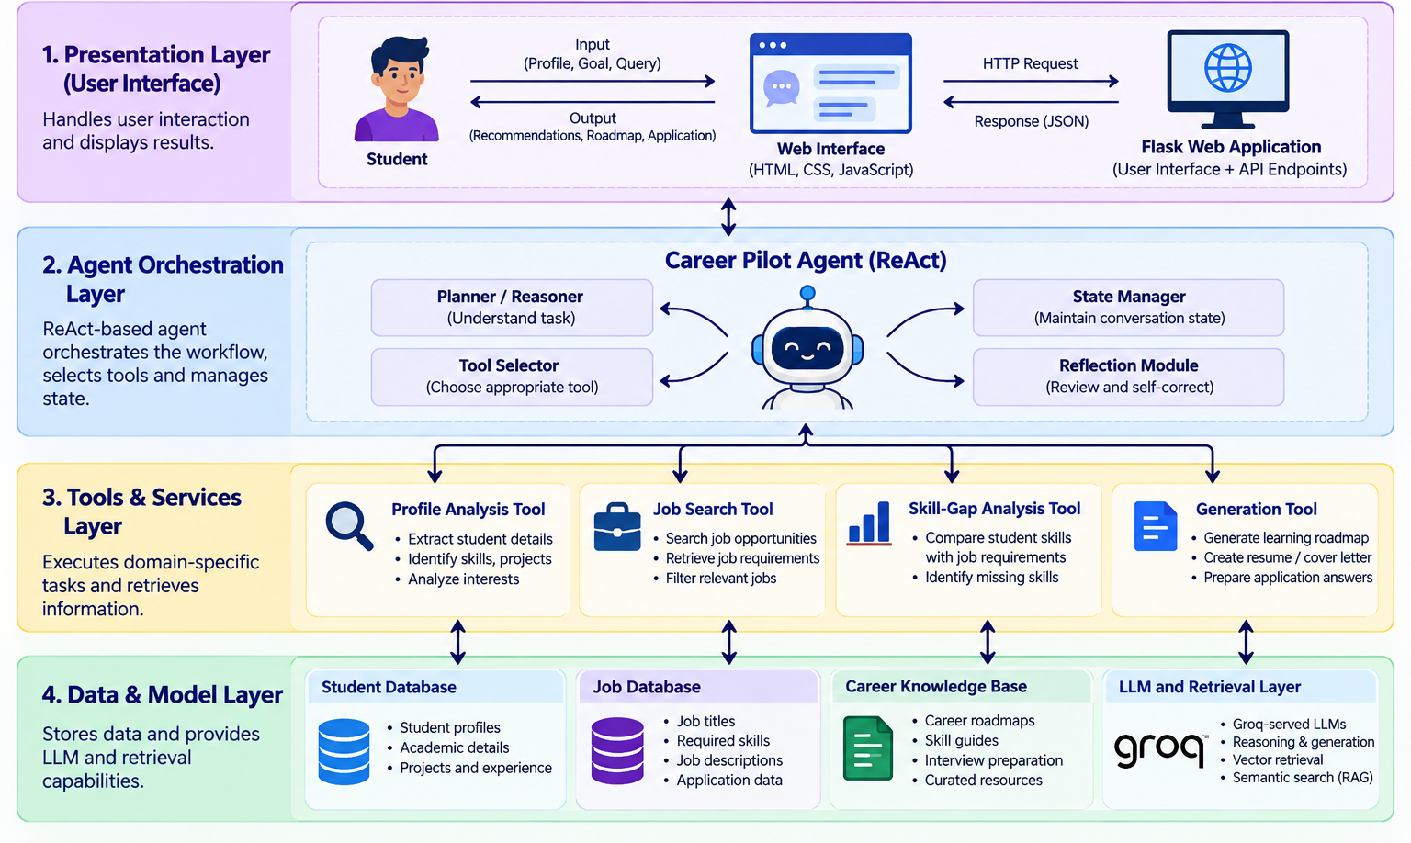
System Architecture: Tiered View
10

Slide 12
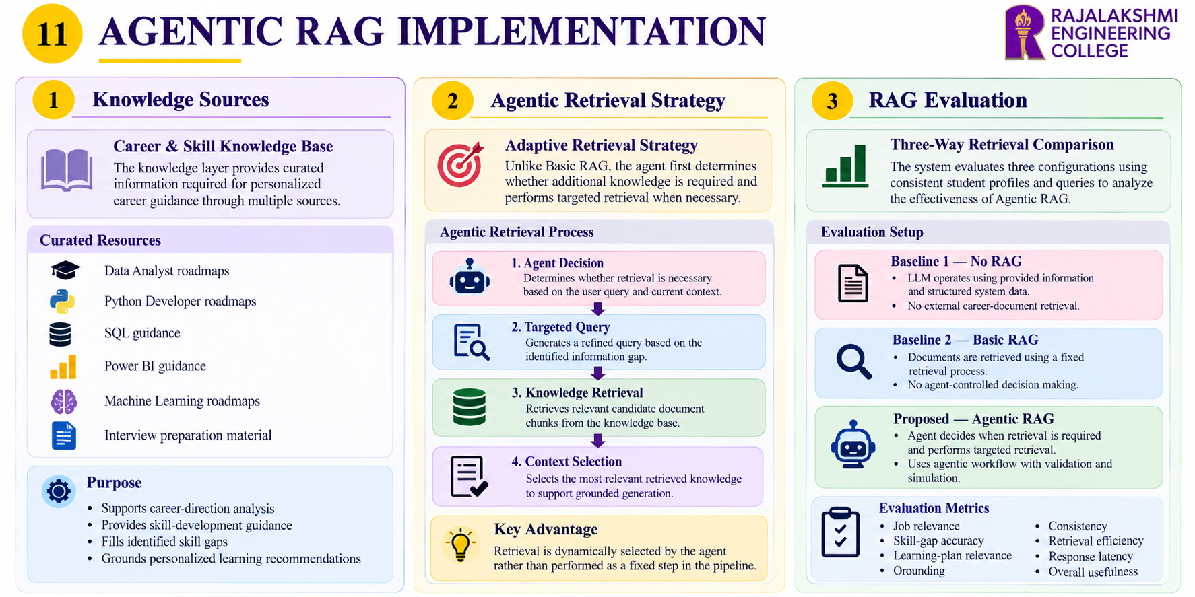

Slide 13
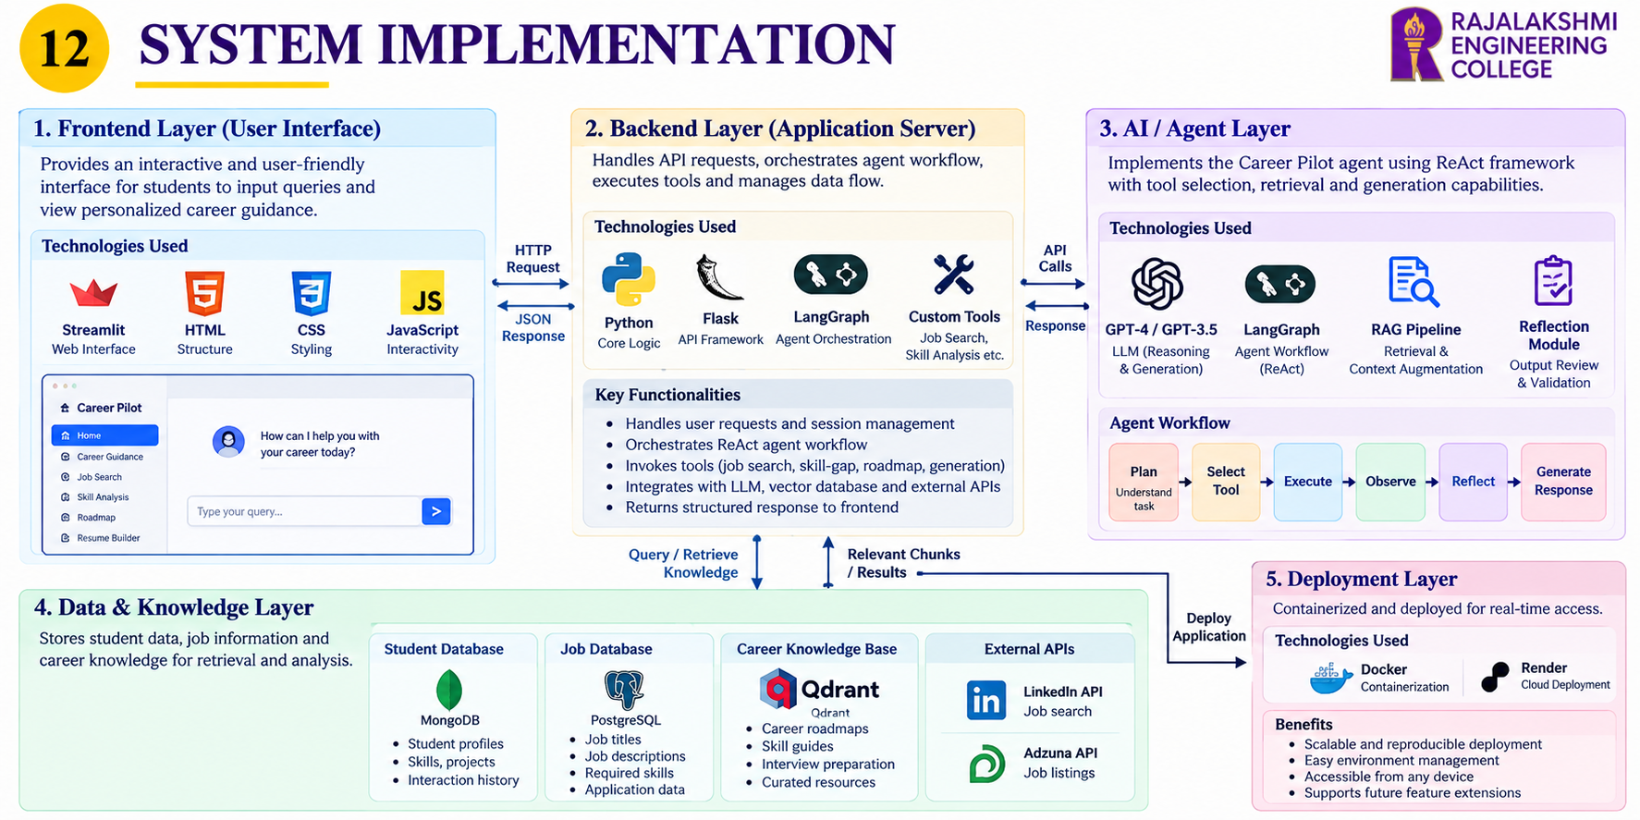
Final review
Department of Artificial Intelligence and Machine Learning

Slide 14
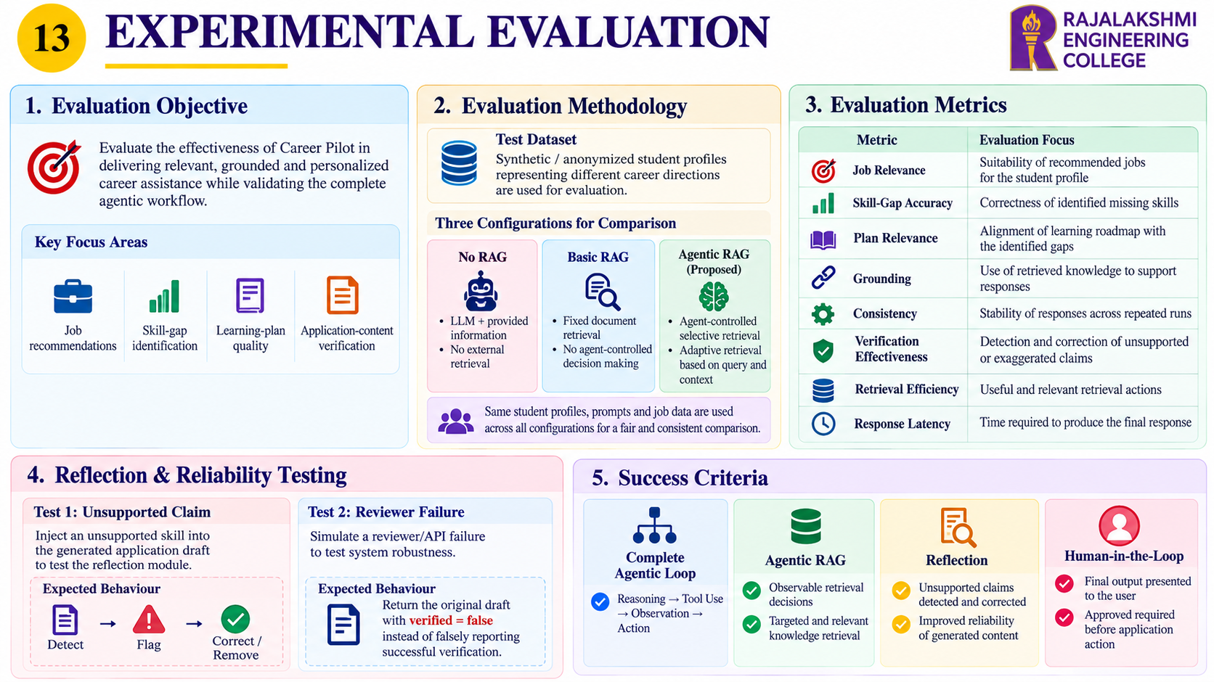
Final review
Department of Artificial Intelligence and Machine Learning

Slide 15
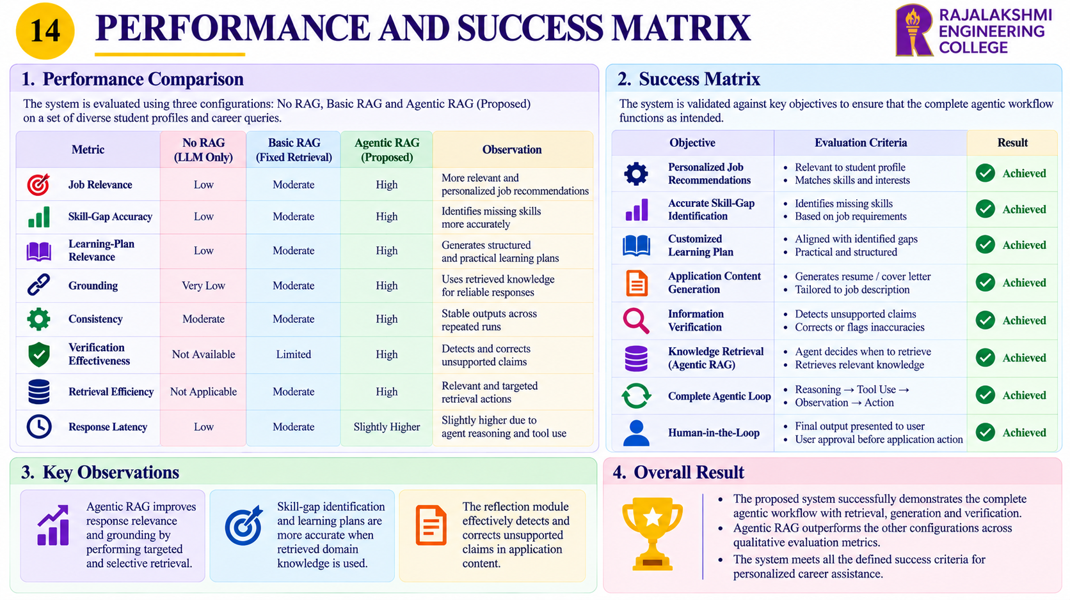
Final review
Department of Artificial Intelligence and Machine Learning

Slide 16
Comparison & Innovation
15
Feature | LLM Only | Basic RAG | Career Pilot
Requirement Understanding | ✓ | ✓ | ✓
Knowledge Retrieval | ✗ | ✓ | ✓
Agentic Decision-Making | ✗ | ✗ | ✓
Job Search & Retrieval | ✗ | Limited | ✓
Skill-Gap Analysis | ✗ | Limited | ✓
Personalized Learning Plan | ✗ | Limited | ✓
Reflection & Correction | ✗ | ✗ | ✓
Human Approval | Limited | Limited | ✓
Adaptive Retrieval | ✗ | ✗ | ✓
Our Innovation
Career Pilot connects Profile Analysis → Job Search → Skill-Gap Analysis → Agentic RAG → Personalized Planning → Reflection → Human Approval in one continuous Agentic AI workflow.
Final review
Department of Artificial Intelligence and Machine Learning

Slide 17
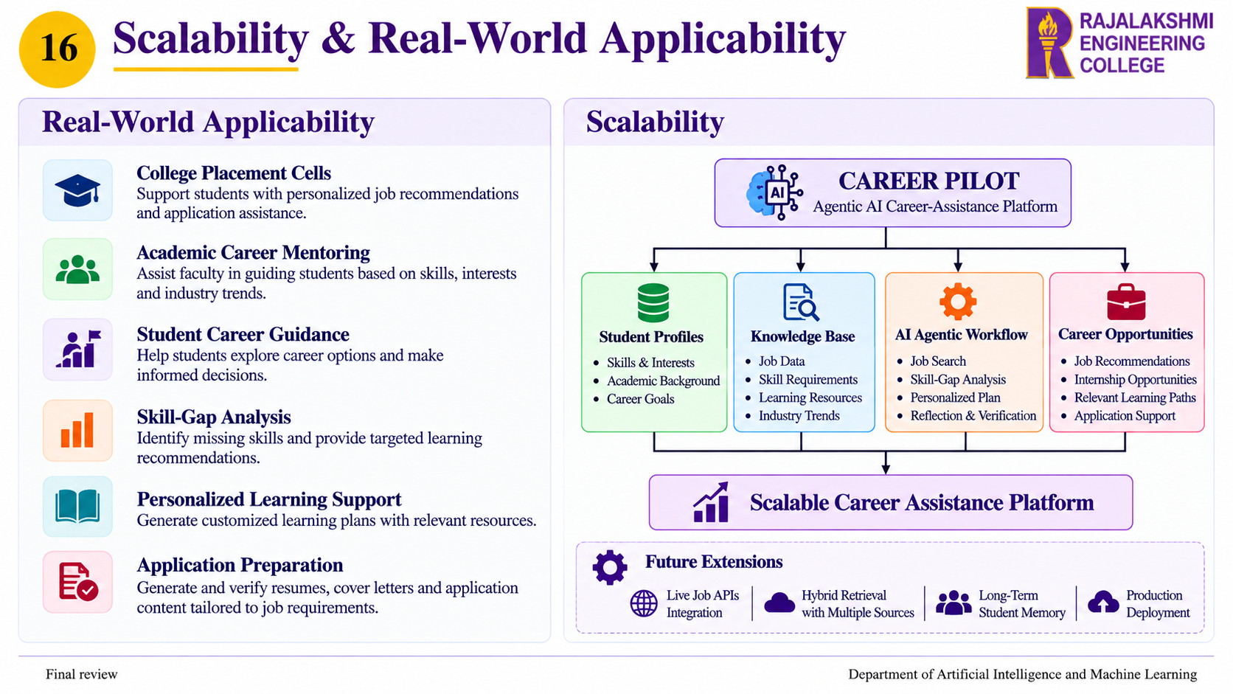

Slide 18
17
FUTURE WORK
Expanded Knowledge Base:
Extend the knowledge base with institution-specific curricula, verified learning resources, and additional career domains.
4. Advanced Retrieval:
Implement hybrid lexical and vector retrieval with reranking to improve retrieval quality for larger knowledge bases.
6. Production Deployment
Strengthen authentication, privacy controls, audit logging, secure external integrations, and deployment infrastructure for real-world use.
2. Long-Term Student Memory:
Maintain student learning history, completed courses, projects, previous skill gaps, and earlier career-advising interactions.
5. Automated Evaluation & Monitoring:
Introduce automated evaluation methods, larger benchmark datasets, retrieval-quality monitoring, and model-error tracking.
3. Live Job Integration:
Integrate permitted live job APIs to provide updated opportunities and current industry requirements.

Slide 19
CONCLUSION
18
Career Pilot: AI-Based Personalized Student Career Advisor:
Career Pilot demonstrates how Agentic AI can transform student career advising from a simple question-answering task into a structured, personalized decision-making workflow.
Key Outcomes:
Personalized Career Analysis: The agent analyzes the student profile, career interests, available opportunities, and skill requirements.
Agentic Decision-Making: The system uses a ReAct-style workflow to reason, select tools, observe results, and determine the next appropriate action.
Adaptive Knowledge Retrieval: Agentic RAG allows the system to decide when additional career or skill-roadmap knowledge is required, instead of retrieving information at every step.
Skill-Gap & Learning Support: The system identifies missing skills and generates personalized learning recommendations based on the identified gaps.
Reliable Application Assistance: The Reflection mechanism reviews generated application content and helps detect and correct unsupported or exaggerated candidate claims.
Human-Controlled Execution: The Draft → Review → Approve → Apply workflow ensures that the student remains in control before any consequential application action.

Slide 20

Thank You
Department of Artificial Intelligence and Machine Learning

